Slide 1
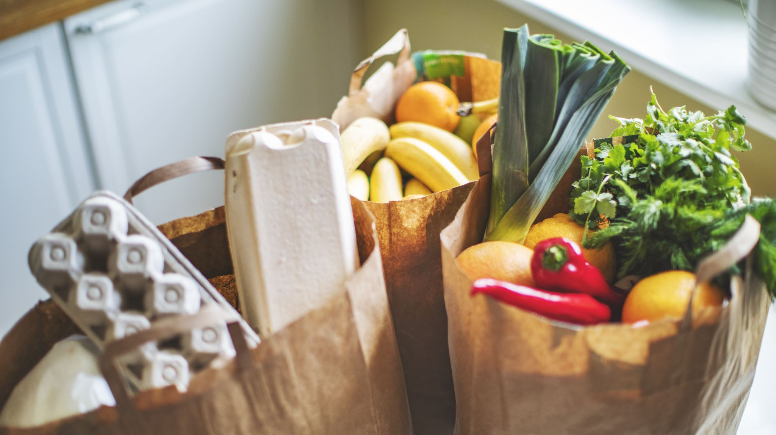
Consumer good Insights
Niharika Miriyala

Slide 2
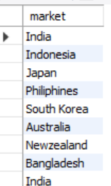
Q) Provide the list of markets in which customer "Atliq Exclusive" operates its business in the APAC region:
Markets where ATLIQ Exclusive Operates
Output:

Slide 3

Q) What is the percentage of unique product increase in 2021 vs. 2020?
% of unique product increase in 2021 vs. 2020?
Output:

Slide 4
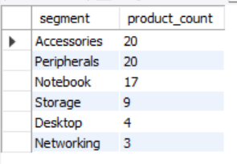
Q) Provide a report with all the unique product counts for each segment and sort them in descending order of product counts.
Unique product counts for each Segment
Output:

Slide 5
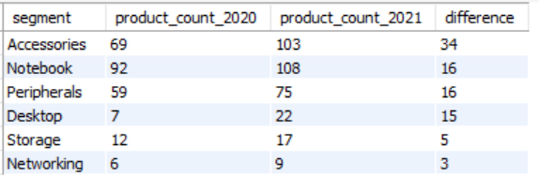
Q) Which segment had the most increase in unique products in 2021 vs 2020?
Segment’s highest increase in unique products in 2021 vs 2020?
Output:

Slide 6

Q) Get the products that have the highest and lowest manufacturing costs
Highest and lowest manufacturing costs
Output:

Slide 7
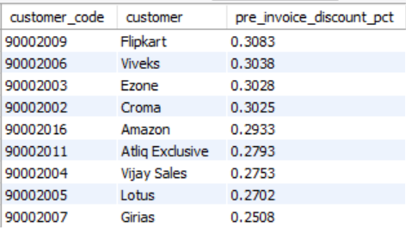
Q) Generate a report which contains the top 5 customers who received an average high pre_invoice_discount_pct for the fiscal year 2021 and in the Indian market.
Top 5 customers who received an avg high pre_invoice_discount_pct for the fiscal year 2021
Output:

Slide 8
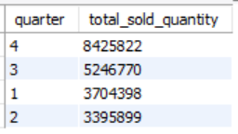
Q) In which quarter of 2020, got the maximum total_sold_quantity?
Highest quarter of Total sold quantity
Output:

Slide 9
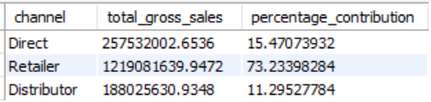
Q) Which channel helped to bring more gross sales in the fiscal year 2021 and the percentage of contribution?
Channel that brought high gross sales in the fY-2021 and the % of contribution
Output:

